Slide 1
Universal Design for Learning & Accessible Learning Experience Design
Gabrielle King, Phillip J. Deaton

Slide 2
Outline
The Myth of Average
Standardized v Personalized Learning
Universal Design for Learning
History and Principles
Implementation
Accessible Learning Experience Design
Principles
Implementation
Discussion
What are the next steps?

Slide 3
The Myth of Average
Curriculum has been designed around the “average” student
Designing for the “average” doesn’t reach all students
Curriculum needs to shift to design for the edges
Notes:
Gabrielle:
How do you design one curriculum that can fit the most individuals? Historically, you would do this by designing for the “average” student. If you design for average it will fit most people, right? Wrong. There are so many students that cannot be reached because we design for the average. There is no such thing as an average learner. Curriculum should be designed for the edges, not the average. By designing for the edges, you will be fitting most, if not all learners within the curriculum. This is where UDL comes into play.

Slide 4
Standardized vs. Personalized
Creating learning artifacts for standardized courses has an element of personalizing
From web design: every user experience is different
This idea of accessibility enforces this as well
Every experience an individual has interacting with digital learning objects is different and can be flexibly altered
Notes:
Altered by Assistive Technology, User Agents, Personalization Settings, and Operating Systems

Slide 5
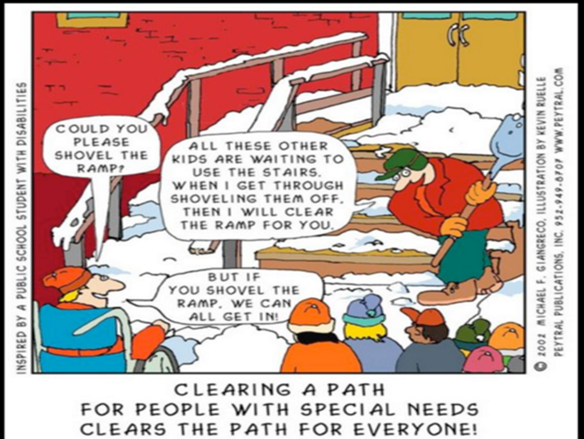
Universal Design for Learning/History
UDL comes from universal design
Notes:
, a term from architectural design that has since broadened into many other fields

Slide 6
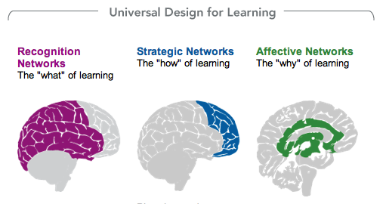
Three Principles
"What Is Universal Design for Learning | National Center On Universal Design for Learning." CAST, 31 July 2014.
Notes:
Gabrielle:
The core of Universal Design for Learning breaks down the “what”, the “how” and the “why” of learning through providing multiple means of engagement, representation, and action and expression. Classrooms are highly diverse and curriculums need to be designed from the start with these diverse learners in mind. A universally designed curriculum is planned to be flexible, and to accommodate all kinds of users, with and without disabilities. The goal of the UDL framework is to minimize barriers and maximize learning for all students.
Provide multiple means of representation
Present content in multiple medias and provide many supports for the information being taught. Technology allows educators to nurture the potential of all students. Simple technological applications we use in our daily life can be applied into the classroom and make a difference for many learners.
Provide multiple means of action and expression
Give students many options to express what they know
Provide multiple means of engagement
Give students choices to fuel their interests and autonomy

Slide 7
Implementation of UDL in the classroom
Universal Design for Learning in K-12
Universal Design for Learning in Higher Education
Notes:
Gabrielle: K-12
Engagement: providing choices for students, emphasis and opportunity on collaboration, kinesthetic activities (“hands-on, minds-on”)
Representation: access to digital reading materials: ebooks and audiobooks, videos used to convey information and experiences opposed to always lecturing, graphic organizers: giving students different resources to help organize thoughts, ideas, and concepts
Action and Expression: use of media to communication information, vary response methods, allow students access to tools and assistive technology
Phil: Higher education
Perhaps the most applicable aspect of UDL is in design of learning objectives. Create technology and sensory neutral assessment and discuss

Slide 8
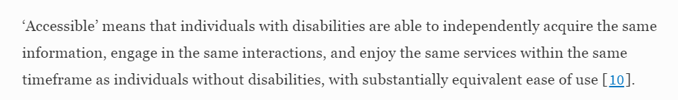
Accessible Learning Experience Design
To follow ALED, focus on creating experiences that are observable and engagable in flexible ways via multiple senses.
Notes:
A definition from settlements.
So what does access mean?

Slide 9
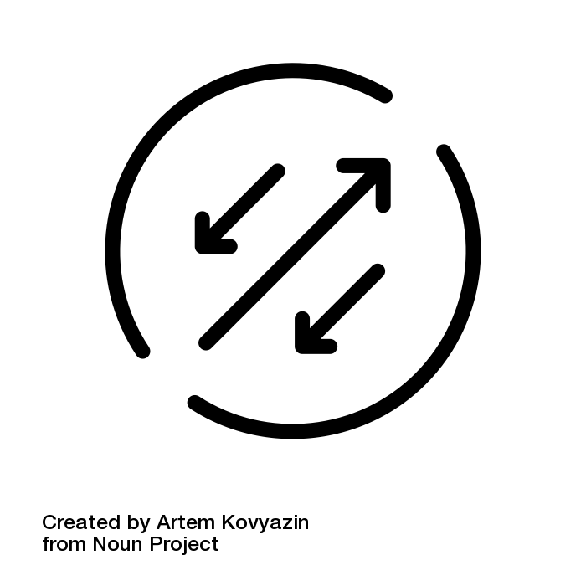
1. Design for the same level of Independence
If meant to be completed individually, aim to create an experience for all
that can do this as well.
Maximize the individual level of dignified access
  You will have to use technology
  and physical space specific technology
  Focus on inclusion and UDL
Notes:
If meant to have peer to peer interaction, ensure that this can take place.
If meant to have student to instructor interaction, ensure that this can take place.

Slide 10

2. Provide the same information
Single sourcing information
  Can focus on upkeep on one space rather than two, and use UDL to maximize access
When to use multiple spaces: if using vended technology that is inaccessible
  Consider vendor-relations advocacy
  Offer in-kind consulting through
  implementation projects to help
  them improve their product for you
  and for others
  If vendors aren’t willing to build in
  access be sure to leverage the market

Slide 11
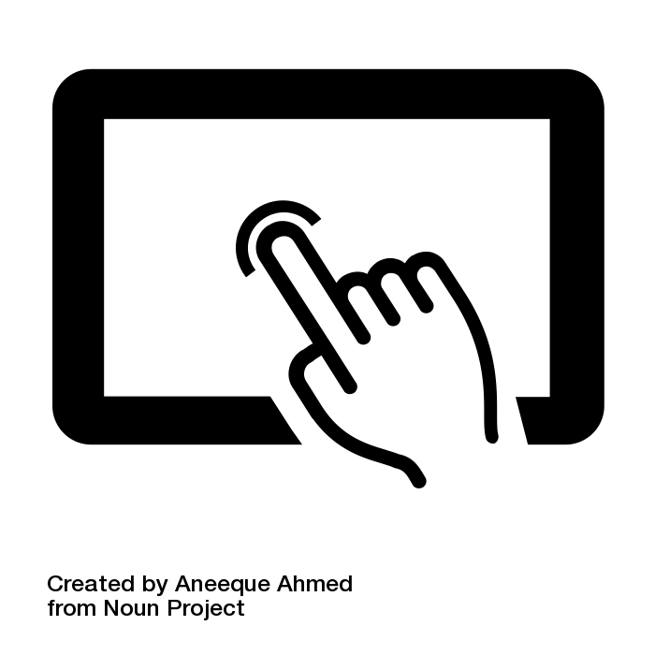
3. Utilize the same types of interactions
One way in which we acquire information is based on how that information is portrayed to us.
  Hierarchy of structural information
  Think about interaction design before
  sensory (e.g., graphic, auditory) design
  Consider observation versus inference
  and how individuals with and without
  disabilities can participate in both

Slide 12
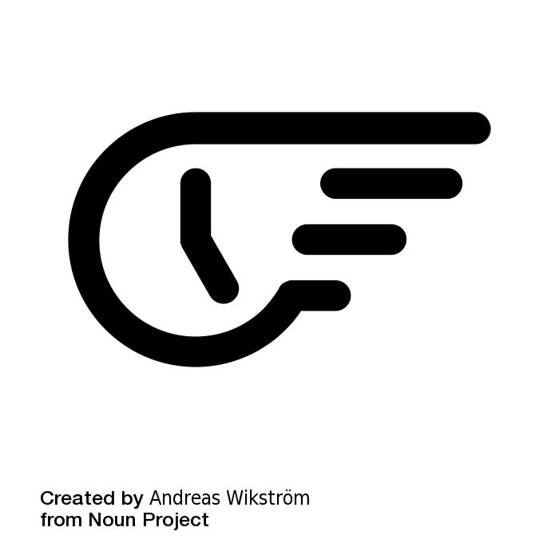
4. Available within the same timeframe
Opportunities are found and followed based on time
  Provide tasks that can be completed in as similar a time-frame as possible, to maximize opportunity.

Slide 13

5. Allow for same level of usability
Consider usability in two ways:
  Usability of using an interface for individuals with a variety of disabilities
  Ease of manipulating and flexibly using content
  to meet learning objectives

Slide 14
Discussion
How do you implement UDL in higher ed or corporate training environments?
How do you test accessibility?
How do you meet/create ALED (what frameworks are necessary?)

