Slide 1
Mobile Accessibility Inspection and Best Practices
James E. Jackson
EIT Accessibility Coordinator

Slide 2
What we will cover
How AT works on Mobile Devices
Talk about what tools you need to develop and test on mobile
Go into detail on a few important aspects of accessible mobile design

Slide 3
Why Mobile Accessibility?

Slide 4
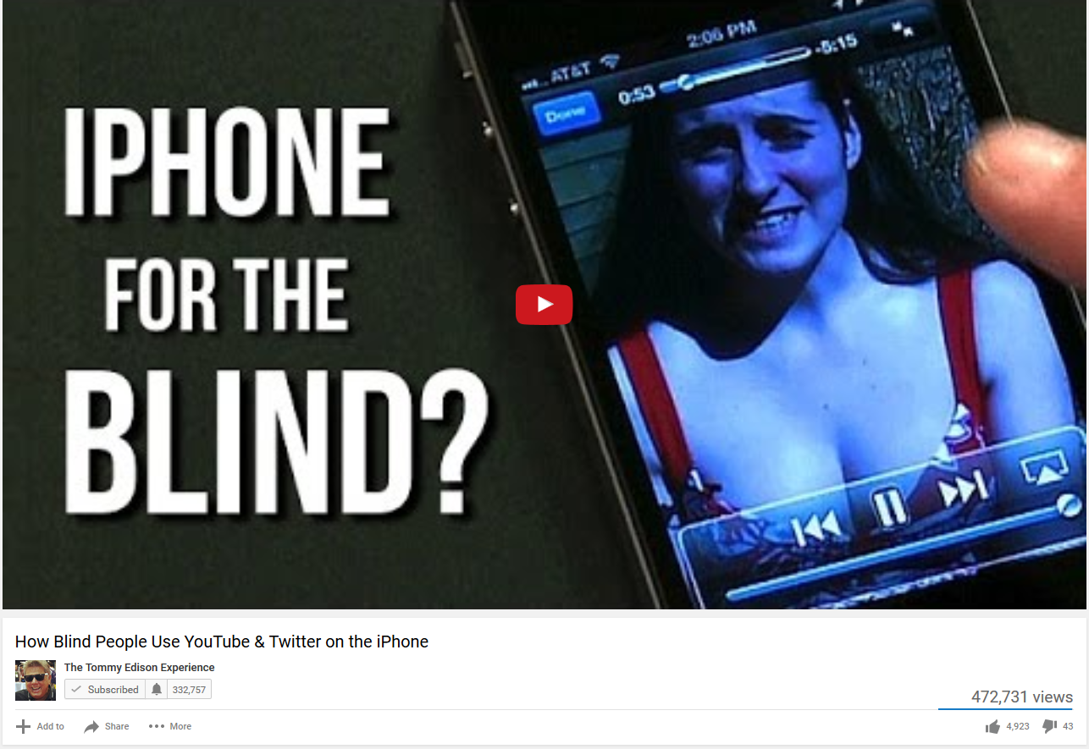
How Blind People Use YouTube & Twitter on the iPhone
Notes:
Link: https://www.youtube.com/watch?v=c0nvdiRdehw

Slide 5
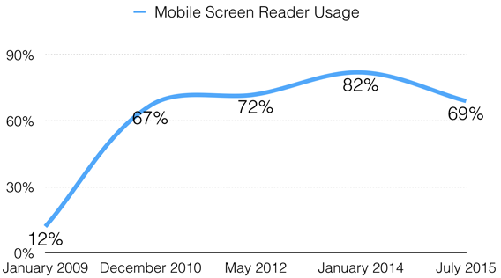
Mobile Screen Reader Usage
WebAim.org, Screen Reader User Survey #5

Slide 6
Applying WCAG to Mobile

Slide 7
What does the W3C say?
Mobile Accessibility: How WCAG 2.0 and Other W3C/WAI Guidelines Apply to Mobile

Slide 8
Understanding Conformance
In addition to success criterion, WCAG 2.0 also has 5 Conformance requirements
Two of these are especially important when applying WCAG to mobile devices
  Requirement 4: Accessibility Support
  Requirement 5: Non-Interference

Slide 9
Testing/Inspection
Need to test with assistive technology
  Right now in mobile this means testing with Voiceover on an iOS device

Slide 10
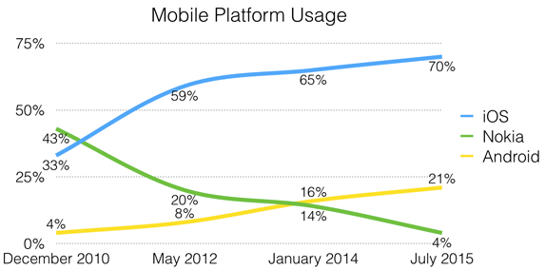
Mobile Platform Usage
WebAim.org, Screen Reader User Survey #5

Slide 11
Android Accessibility
For screen reader users, Android accessibility has lagged iOS
  Marco Zehe, 30 Days with Android
Google has made significant progress in 2016
  Android App Accessibility Scanner
  Features for users with Low Dexterity
    Switch Access
    Voice Access

Slide 12
Testing/Inspection
Access to the code as it is rendered on a device is helpful
  Emulation is easier
  Debugging lets you be more certain that the code conforms to a real use case

Slide 13
Screen Reader Support

Slide 14
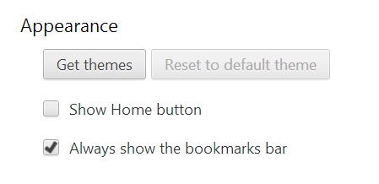
Name, Role, Value
Name
  How an element is identified (e.g. its label)
Role
  An element’s type and its functionality
Value
  Current status of an element including its state, properties, and values

Slide 15

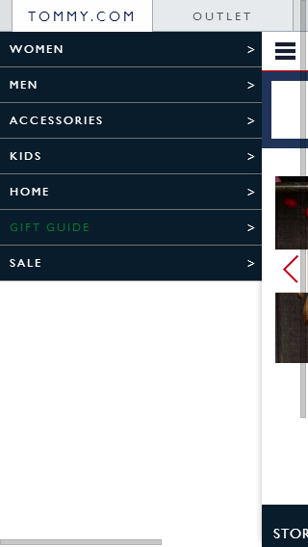
Example- tommy.com

Slide 16
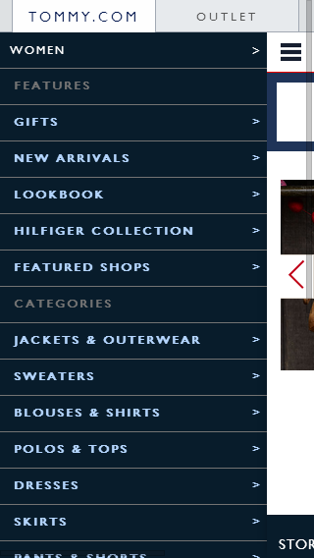
Example continued

Slide 17
Communicating Element State
Ways to communicate hidden state
  CSS “visibility:hidden”, or “display:none”
  HTML5 “hidden” attribute
  aria-hidden=“true”
Chose the method which works best for your design
  The CSS and HTML5 methods will hide the content from the visual display as well
  The ARIA method may not have as wide of support
Make sure it works with assistive technology

Slide 18
Communicating Element State Cont.
Make sure that the main content is also hidden when the pane is open

Slide 19
Keyboard/Touch screen support

Slide 20
The Touch Screen Gap
WCAG 2.0 does not have guidelines that apply specifically to touch screens
This is not a “Get out of Jail Free Card”

Slide 21
Supporting Assistive Technology
You still need to support assistive technology
  This means supporting AT specific touch screen gestures
If a website is not operable, it won’t meet the spirit of the law, even if it technically conforms to the standard

