Slide 1
Making PowerPoints Accessible
Natalie Orcutt, Chris Frey, Aaron Ngo, Jojo Otchere and Phil Deaton
Notes:
Jojo

Slide 2
How AT reads an inaccessible PowerPoint
https://mediaspace.msu.edu/media/Making+PowerPoints+Accessible/1_4c8ip6hg
Notes:
Phil & Jojo

Slide 3
Importance of PowerPoint Accessibility
PowerPoints are a key learning object for sessions and directly link to how students engage with you as an instructor
PowerPoints are used in administrative presentations, conferences (meta), everywhere to provide overviews of connected material
  How are folks supposed to critically engage in order to make decisions, understand and further research, and follow along in class if they cannot access your PowerPoint?
PowerPoints directly link to inclusive spaces in all of these contexts
If a PowerPoint is accessibly provided to an individual, they can participate
Notes:
Phil

Slide 4
Importance of Titles
Slides without titles will not be read by AT
Titles also give the user an indication of where they are in the presentation when skimming through the content
Consider “invisible titles” where necessary
Notes:
Natalie

Slide 5
Titles
Even if slide content is a continuation of a previous slide, each slide should still have a “Title” or “Title 1”
Consider using language like “Part 1 of 2” if continuation
Titles should be descriptive of content within context of presentation
Notes:
Natalie

Slide 6
Importance of Alt Text
What will this improve? A student using a screen reader to view the content on your lecture slides will be able to hear a brief description of any images on the page, as well as in the correct order a viewer would perceive them in relation to the text
Benefits students with neurodevelopmental disabilities as well and increases indexability for images
An important thing to figure out when it comes to alt text is the image’s context and how it is functioning in the PowerPoint.
It is also important to define how to use alt text within the image’s context and function.
Notes:
Aaron & Phil

Slide 7
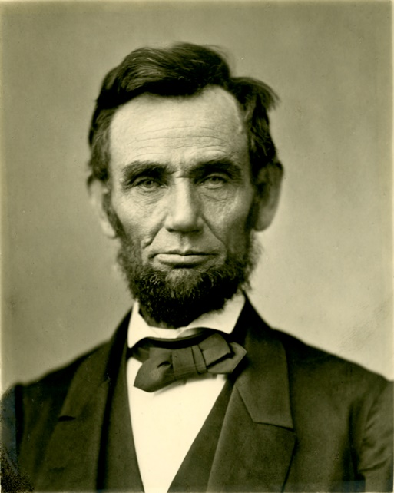
Importance of Alt Text
How to determine context and function for alt texting images:
Abraham Lincoln was the 16th President of the United States from 1861 until 1865
Usually an image presents context is difficult and hard to determine.
In this particular example, the image of Abraham Lincoln is present to inform viewers of his identity.
Since there is text surrounding the image, the most appropriate alt text would be “Image of Abraham Lincoln”.
In most cases, images have functions if contained within links or are clickable.
This example image has no function because it is not in a link or clickable.
Notes:
Aaron & Phil

Slide 8
Understanding Visual Objects
Each individual visual object makes one argument, demonstrates one point, can be observed
Macro vs micro affordances
  Pieces or building block aspects in the visual can be interpreted differently, but focus on the tactical reason for why that image was used in context
  Macro provides a tactical understanding of a concept in a visual, micro is the building blocks for the visual
Capture visual objects individually where possible, to create alt text on one visual object
  There are cons to this in terms of sustainability, single sourcing.
Notes:
Aaron & Phil

Slide 9
Alt Text
To do this:
  Select the image you want to add alt text to
  Right click on the image
  Click “Format picture”
  In the Format Picture panel that will appear on the right side of the slide select the icon that looks like a square with arrows and measurement bars around it
  Select Alt Text
  In the DESCRIPTION not the Title field, add a few words describing what the image is
Note: Alt text is meant to be as concise as possible for the screen reader to read, and alt text should not be used on images that are only serving a decorative purpose on the slide
Notes:
Aaron & Phil

Slide 10
Reading Order and Slide Organization
How to edit your reading order
Go to a slide and click on any text frame
Click on the “Format” button at the top of the page
Click “Selection Pane”
Notes:
Chris

Slide 11
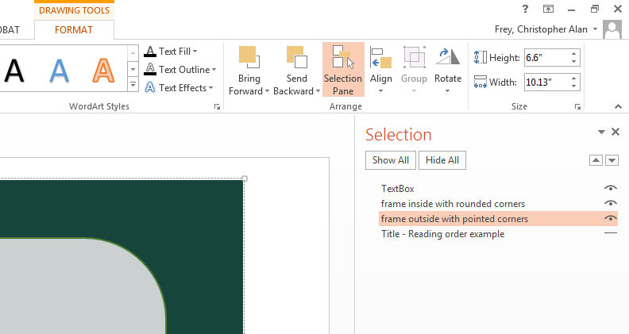
Here you will be able to rearrange the reading order and double check for titles
Notes:
Chris

Slide 12
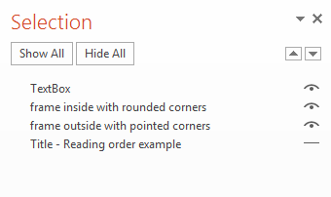
Reading Order and Slide Organization
Reading Order is from bottom to top
Z-axis layer is also controlled here, unfortunately
Notes:
Chris

Slide 13
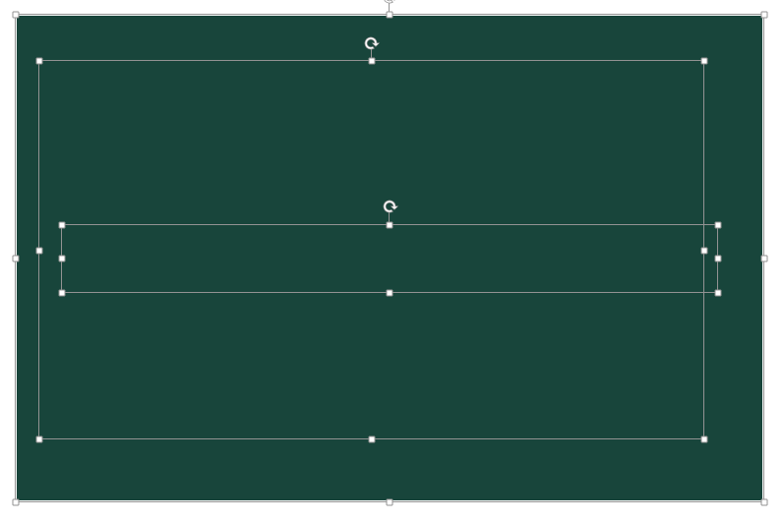
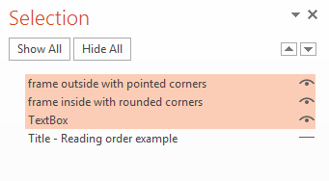
Slide Organization (cont.)
Notes:
Chris

Slide 14
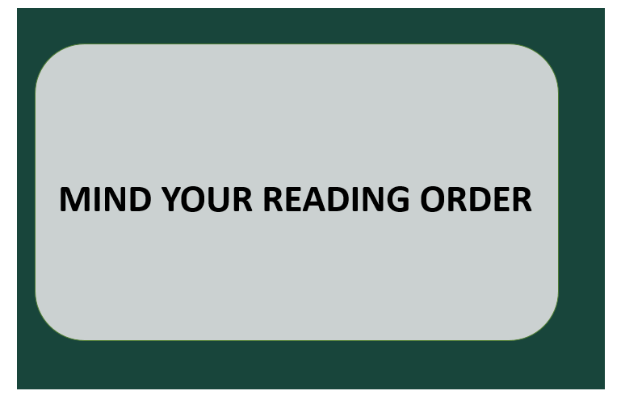
Slide Organization
Be considerate of content and layers
Consider flattening or redesigning images
Notes:
Chris

Slide 15

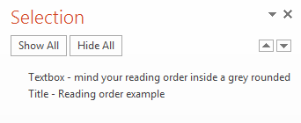
Slide Organization (cont.)
Flatten graphics to eliminate redundant bits
Notes:
Chris

Slide 16
Reading Order & Slide Organization
Flow charts are ripe for these semantic choices
Notes:
Chris

Slide 17
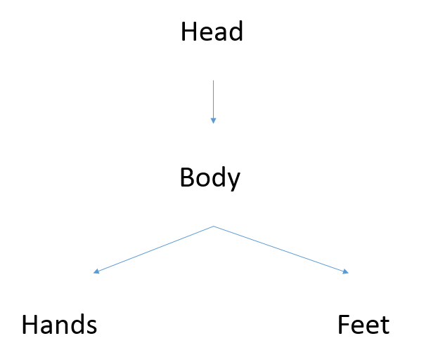
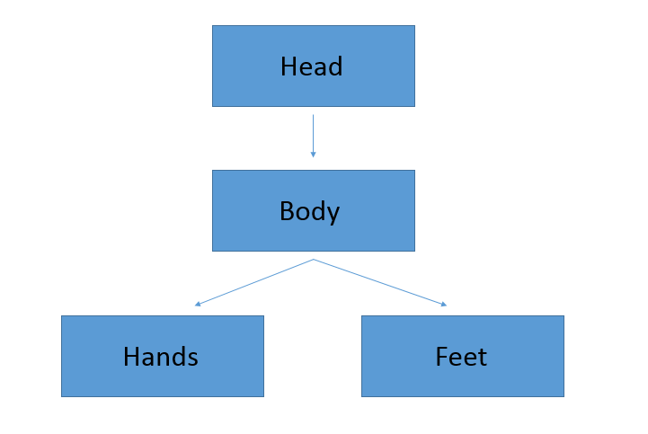
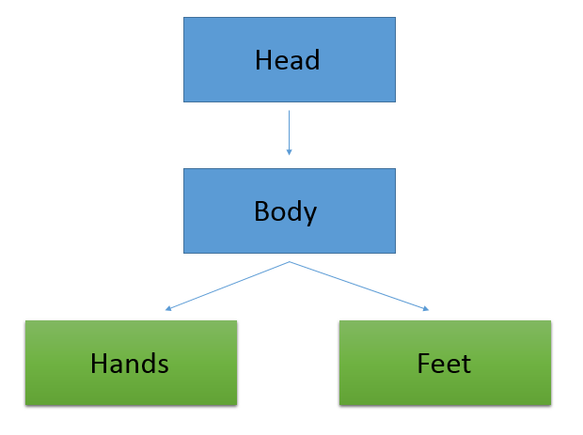
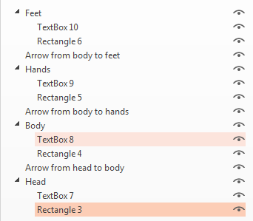
Reading Order & Slide Organization
Notes:
Chris

Slide 18
Short Comings of Microsoft PowerPoint
On a Mac, the Selection Pane is incredibly hard to deal with, if possible try to find a PC to check all of your PowerPoints after you’ve made them
Groups of objects can become really rigid and hard to manipulate
A screen reader will only read the content in the “Presentation Mode”
Notes:
Natalie

Slide 19
Accessible face to face presentation
Be descriptive of graphics and charts
Avoid phrasing such as “as you can see”and try to provide a short description of what you are describing
  This engages observers on multiple levels (senses) and both reinforces concepts and ensures access for some disability groups
Notes:
Phil

Slide 20
Accessibility Hacks in PowerPoint
“Snipping” or screenshotting visuals or complicated flowcharts and adding alt text to describe the entire argument
Changing the semantic value of objects or elements in how they are named
Notes:
Natalie

Slide 21
Conclusion
PowerPoints are one of the most common learning tools at Michigan State & designing accessible lectures only improves the learning ability of all students
Notes:
Jojo

