Slide 1
Why student accessibility teams are great!
Nate Evans, Manager, MSU IT, Hub for Innovation at Michigan State University
Phil Deaton, Web Accessibility Specialist and Instructor at Michigan State University
Heidi Schroeder, Accessibility Coordinator at Michigan State University Libraries
Josephine Foguth, Student Accessibility Intern at MSU Libraries
Irfan Mir, Web Accessibility Intern, MSU IT
Brian Flynn, Universal Design Intern, MSU IT
Rachel Wilcox, Universal Design Intern, Broad College of Business
Landie Berry, Student Accessibility Intern at MSU Libraries

Slide 2
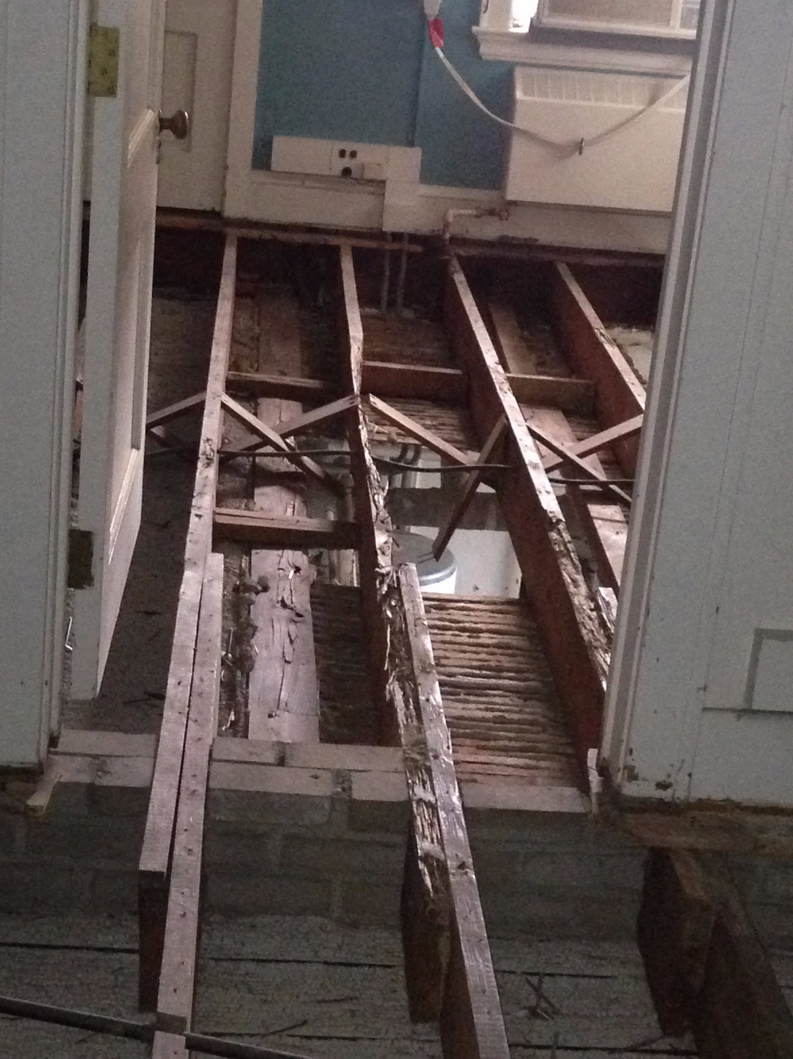
Notes:
Image of termite infested floor joists, which is where our new DCAT accessibility internship lab is now located.

Slide 3
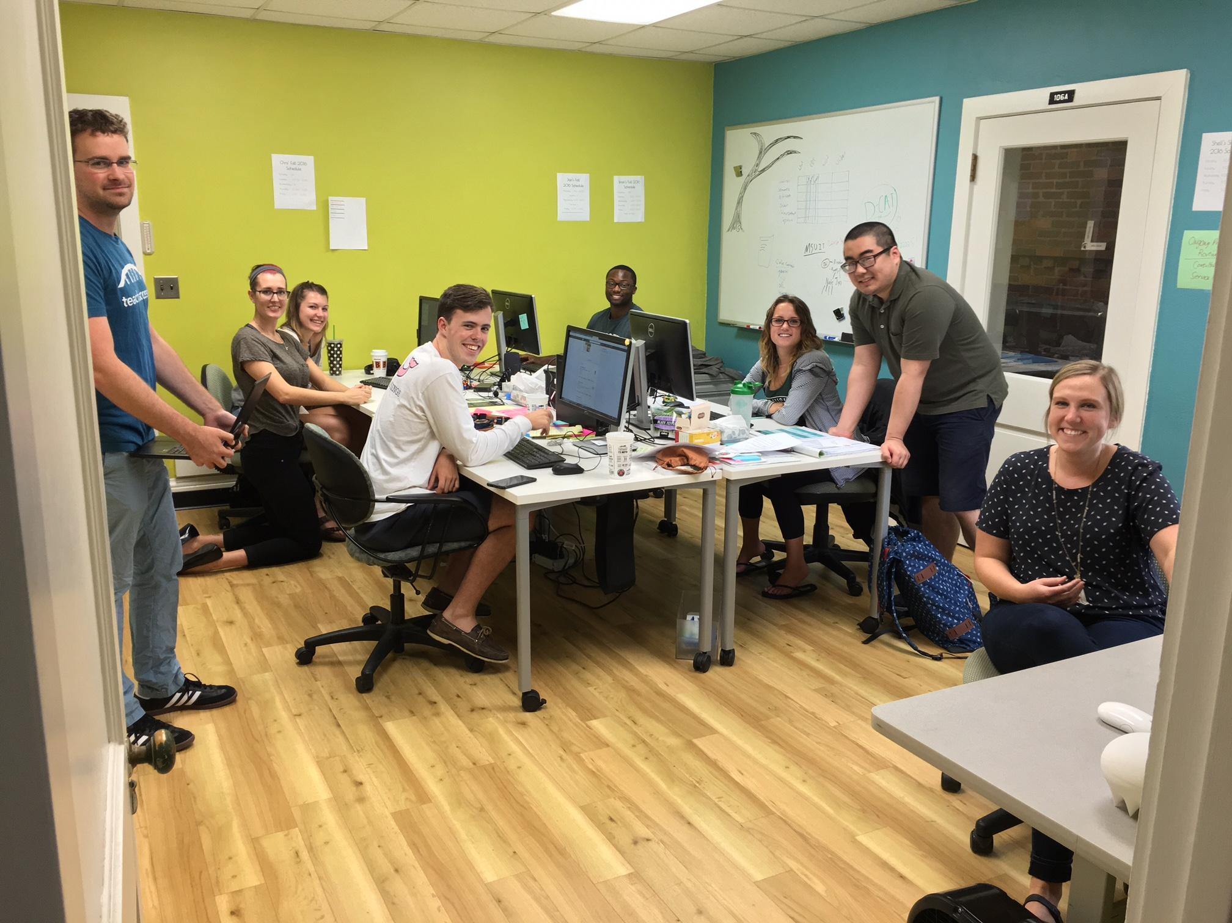
“Yeah, it is a super cool app, but it’s inaccessible. I can’t recommend it...”
Notes:
Image of students in our DCAT student lab. The accessibility culture at MSU is shifting to the point where, if our students find accessibility problems with software, and have the means to create awareness and make accessibility improvements to it.

Slide 4
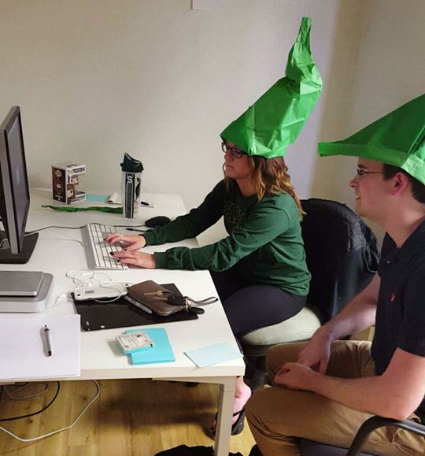
The model in MSU IT - Web, Courses, Products
A huge amount of work needs to be done to create a more accessible campus
Our goal is to create advocates in the university system
Faculty, staff, administrators, and students
Students teach each other
Departments provide funds
We interview/hire/manage students
Notes:
How we do it. The vision/driving forces.
Hiring
training/development
Students teach each other.
Programs develop task list.
Management of student comes from us not the program.

Slide 5
From a MSU Academic Unit’s Perspective...
MSU Libraries:
Has both EIT to test and tons of content to remediate/make more accessible. Hired two accessibility students in Spring ‘16.
  Primary staff member intending to manage students left Libraries.
  Libraries’ Accessibility Coordinator very busy (& getting ready for maternity leave).
  “Transferred” students to DCAT in November ‘16.
Notes:
DCAT model very appealing to MSU Libraries for several reasons:
Logistically: Heidi is getting ready to leave for maternity leave - there was really no one else at MSUL who could take over the management of these students.
Technically: The technical accessibility knowledge at DCA surpasses what Heidi can offer.
Training: DCAT will definitely be able to train MSUL students more efficiently/better in the future.
Support: The Libraries really likes the idea of our two students working in an environment with other students working on accessibility for other colleges/departments/units. And having Nate and Phil there to ask questions to.

Slide 6
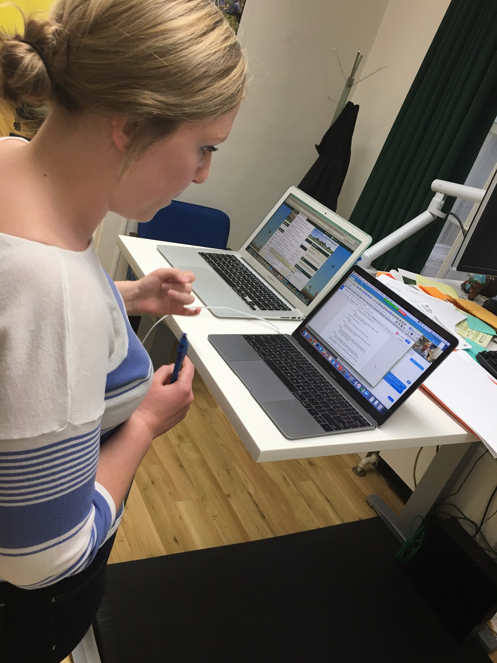
13 student employees
8 majors
Supporting over 35 colleges and departments
Freshmen - Senior
*Had never seen the original star wars movies before working with DCAT.
Notes:
Image of one of our student consulting with a faculty member about the accessibility of their course.

Slide 7
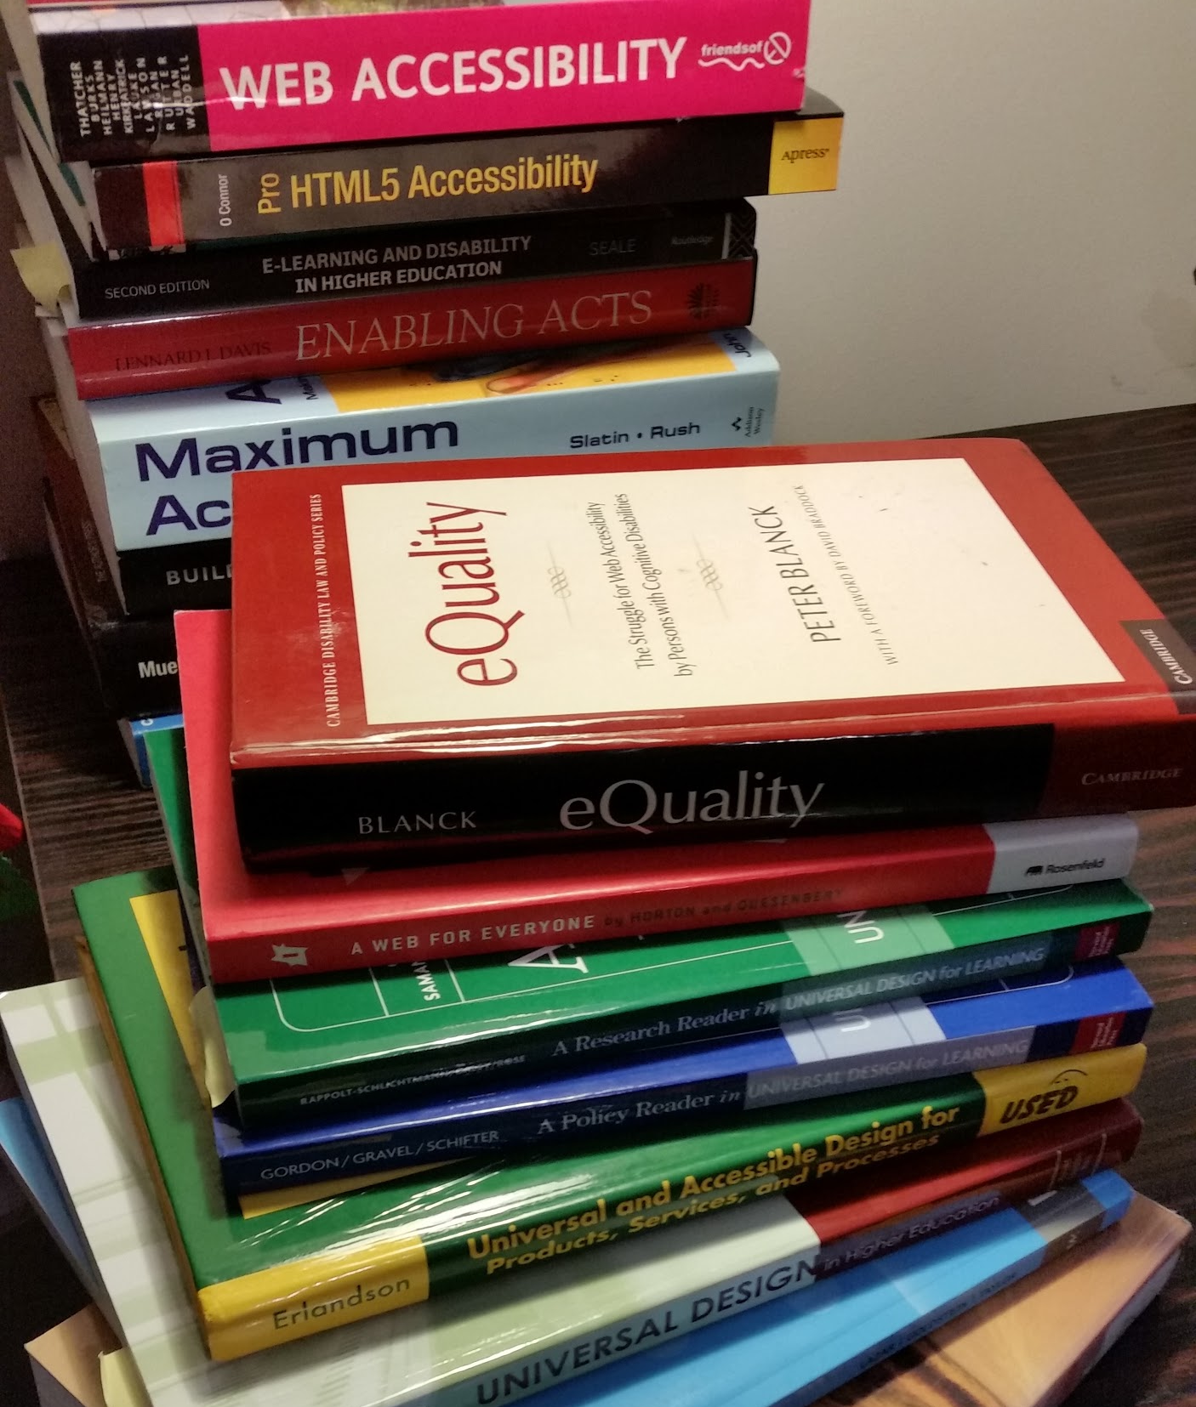
Student Panel
What drew you into the position, and what was it like getting started?
What was your training like/how did you get up to speed?
What do you like most/least about working in the student lab?
Why do you like being involved with accessibility or software/product improvements at MSU?

Slide 8
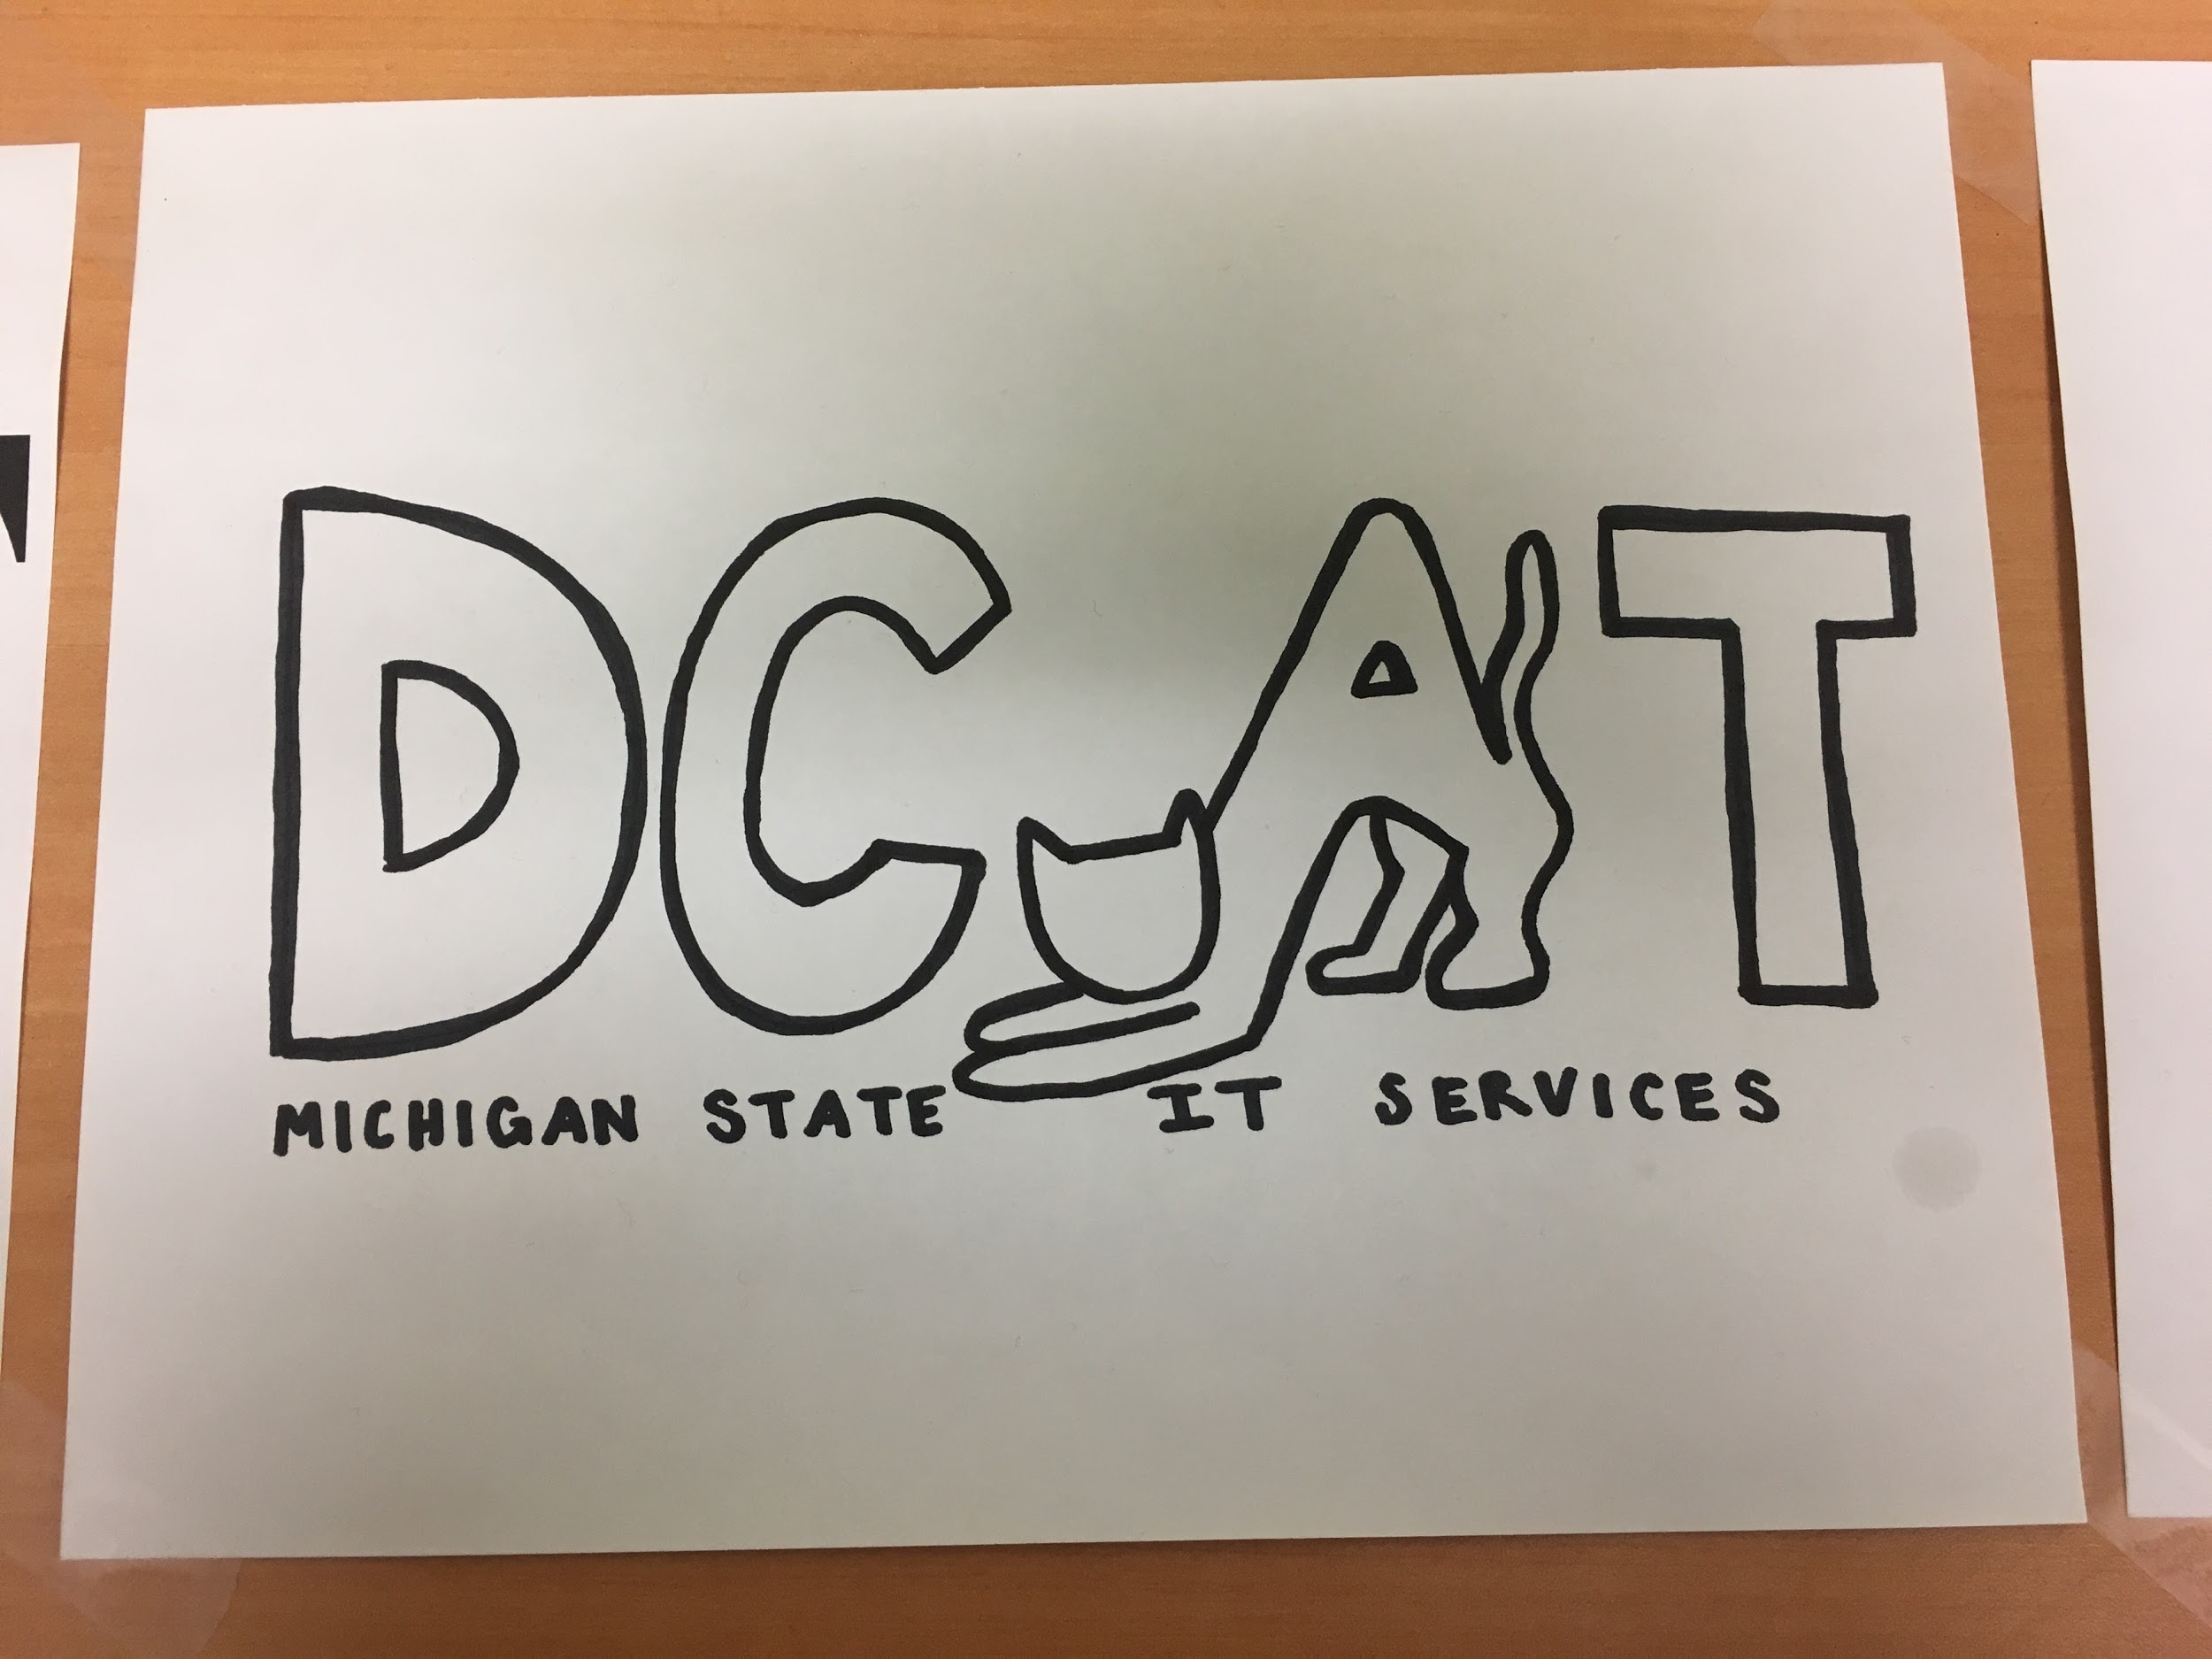
Student Panel, Continued
What has been one of the biggest project challenges that you have worked on?
How would you improve the work environment, or internship experience?
What has changed about the way you think about accessibility?

Slide 9
Thank you!
ne@msu.edu
hschroed@msu.edu

