Slide 1
Applied Advocacy:
How to Approach Accessibility
Phillip J. Deaton
Web Accessibility Specialist
-
Instructor, Disability in Society, Education and Pop Culture
Brooke Knapp
Digital Accessibility Intern
-
Student, College of Nursing
Jake Gattuso
Undergraduate Student
-
College of Lyman Briggs

Slide 2
Legal and Social Aspects
Section 504
  1973. Statute preventing discrimination of persons with disabilities
ADA
  1990. Ensures equal access and opportunity
Issues in Society
  Spark desire for change
Legal Change
  Determines social change

Slide 3
Vocabulary: Principles of Disability
Disability: A condition that limits daily life
Impairment: A disability of a specific kind
Accessibility: Aim to make means of entry (digital/physical) more easily facilitated
Inclusion: Process of encompassing a wider range in the diversity of people

Slide 4
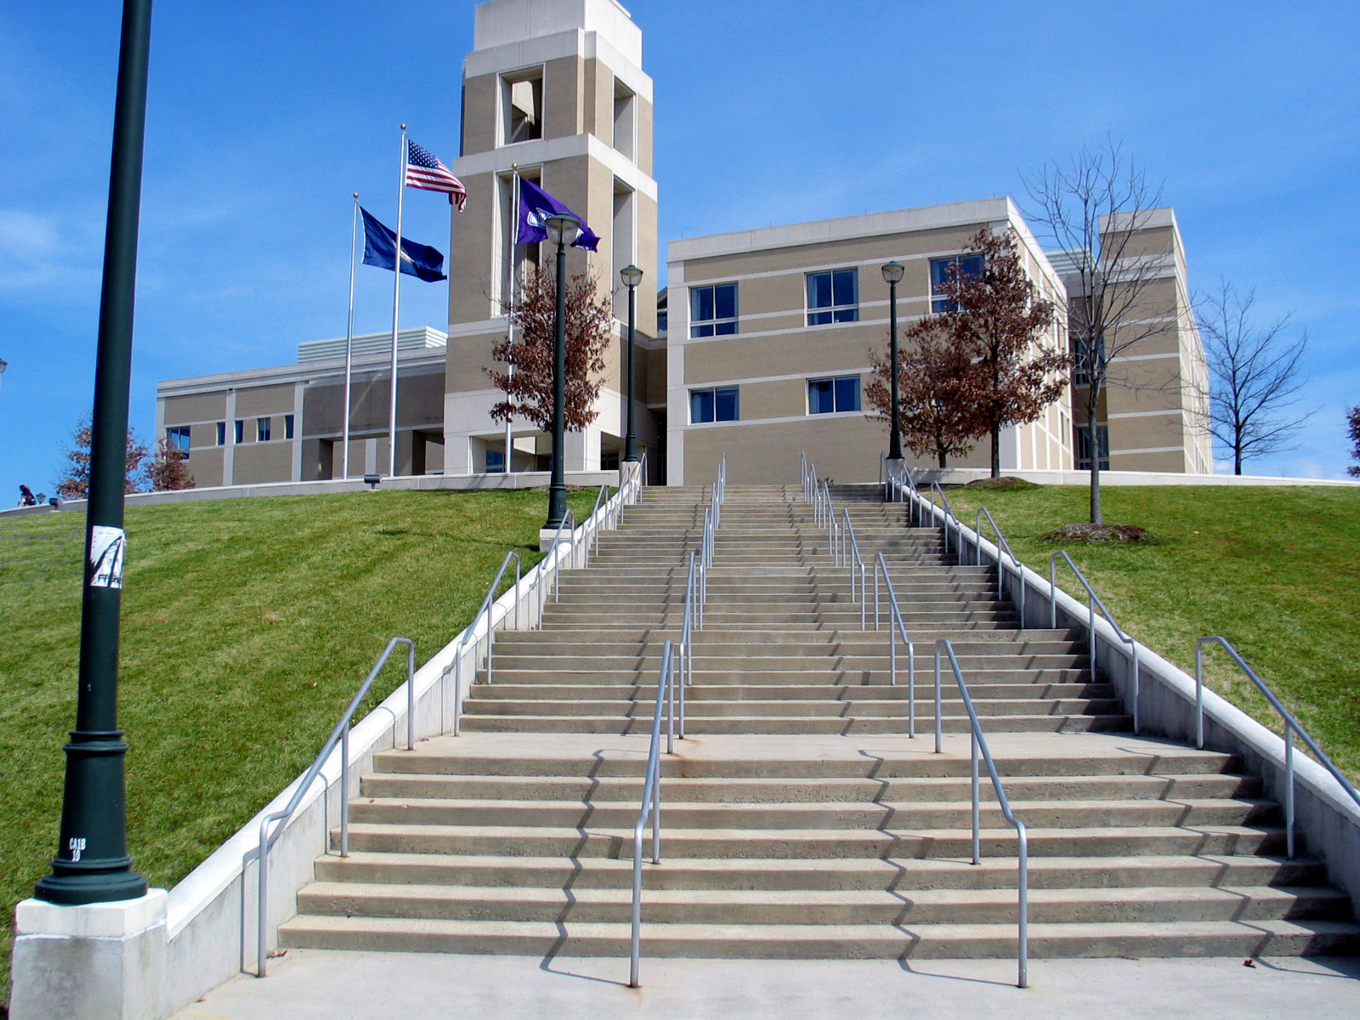
Cultural Change
1 in 4 people in the United
States has a disability
Impairment vs. Disability
  Thinking on a broader scale
Policy vs. Persons
  Advocacy on an individual basis
Reactive vs. Proactive
  Intentional design
https://commons.wikimedia.org/wiki/File:ISAT-CS_Building_stairs.jpg

Slide 5
Process Change
Everyone who conducts scholarship needs to understand access
Conducting can be creating or communicating the creation of scholarship
Top-down
Bring access into institutional conversation on diversity
Listen to students and persons with disabilities
Think about scholarly accountability
Conduct scholarship and fund scholarship in the areas of disability
Bottom-up
Keep having conversations on disability and diversity
Don’t be afraid to work with others to help them understand accessibility
Do research that benefits persons with disabilities
Do accessibility, always, but prioritize

Slide 6
Current Landscape for change
Individuals (students and staff and faculty) are working on accessibility
MSU has teams focused on accessibility, like DCAT, like RCPD
  Remediation
  Consultation
  Presentation
For processes to change, laws and regulations have to coincide with disability principles and have to positively impact culture surrounding disability issues
Global landscape - UN CRPD, Web Accessibility Initiative (WAI)

Slide 7
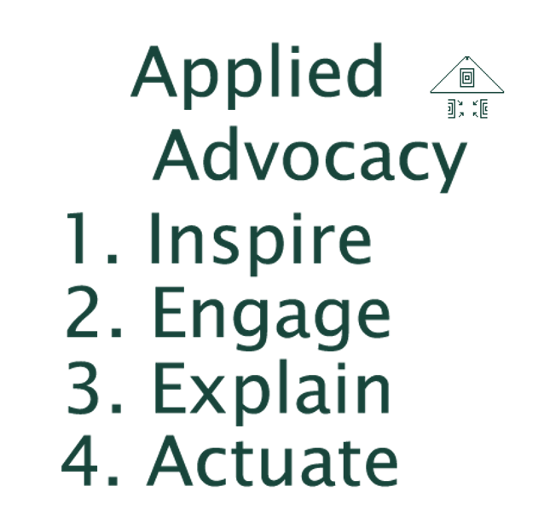
Applied Advocacy
Applied advocacy focuses on
systems change
individual to individual interaction
collaboration
impact the experiences of individuals, communities, and systems now.
Strategic: Connect with others’ initiatives.
Tactical: Provide steps to move forward.
Tactful: Win hearts, then minds.

Slide 8
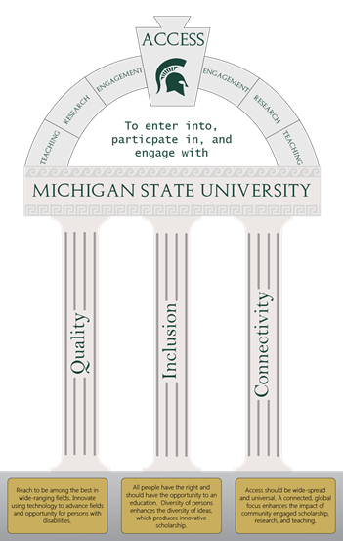
Accessibility for Persons with Disabilities

Slide 9





Advocacy Lexicon
Change: To make different.
Access: To enter into, participate in, and engage with.
Conducting: To organize, administer, coordinate, or create knowledge through scholarly activities.
Scholarly Accountability: An intrinsic and extrinsic rule of research (expounded on through the Belmont Report and others) that states that all research should be for the benefit of humankind.
Applied Advocacy: Championing causes that benefit humankind in ways that inspire, engage, explain, and actuate.

Slide 10
Contact
Phillip J. Deaton
Web Accessibility Specialist & Instructor
deatonph@msu.edu
Brooke Knapp
Digital Accessibility Intern & Student
knappbro@msu.edu
Jake Gattuso
Student
gattusoj@msu.edu

